Slide 1

Chicken Currys
eCommerce & Customer Experience
Personalised Simple Search System
Currys Laptop Buying Assistant

Slide 2
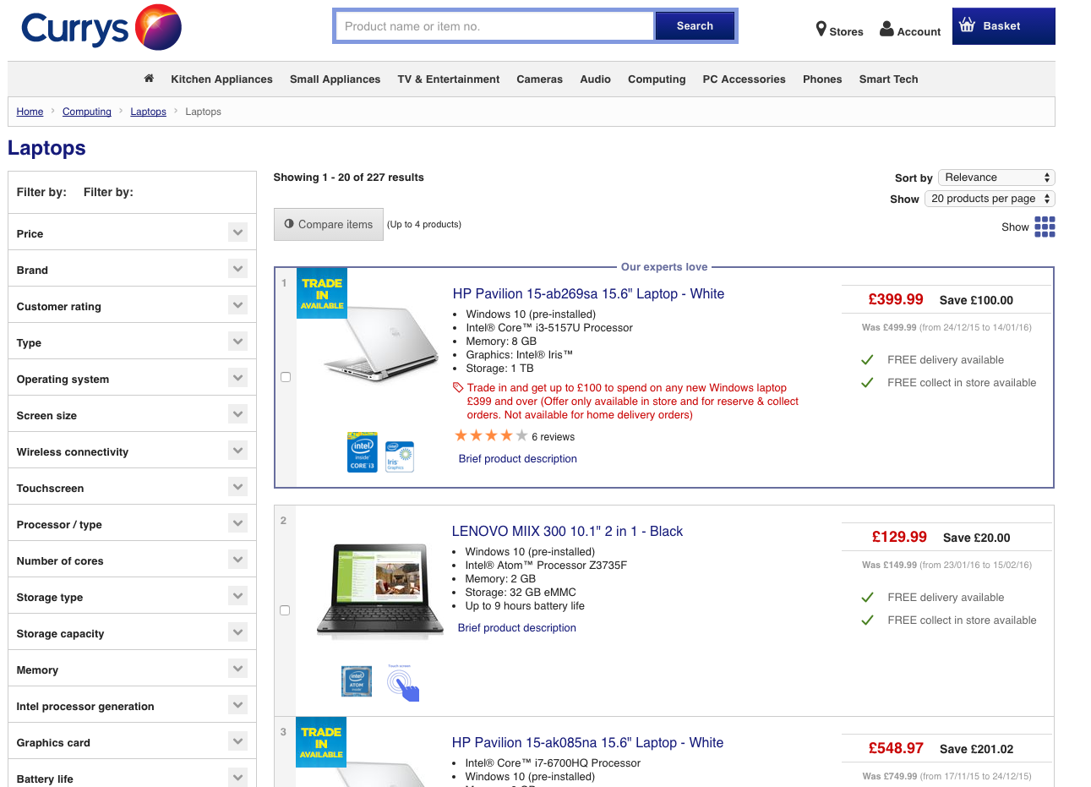
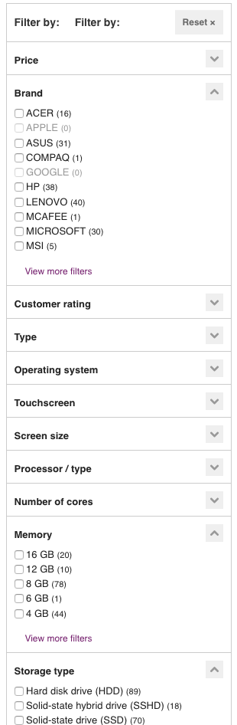
Substitutes
eCommerce websites today

Slide 3
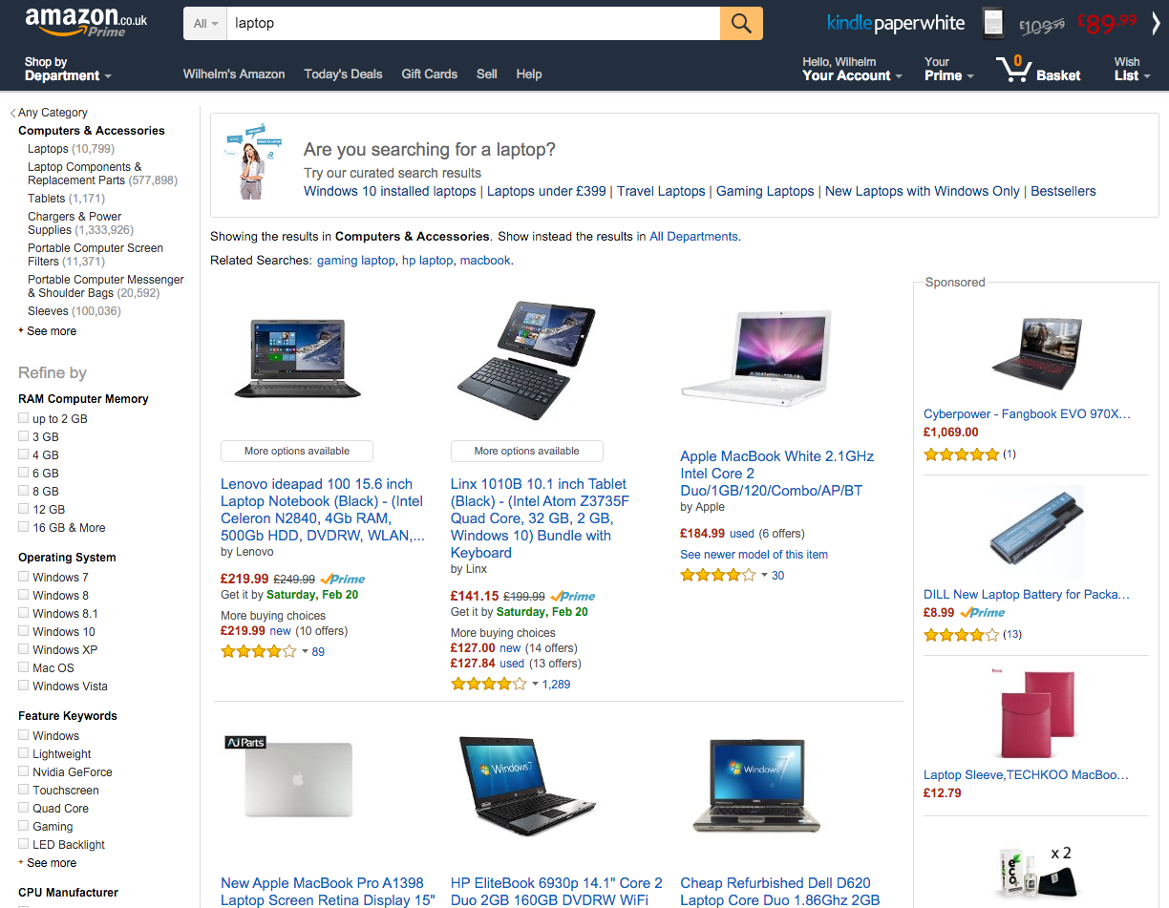

Slide 4
The project’s goal is to develop a simpler search system for everyone.
“
”

Slide 5
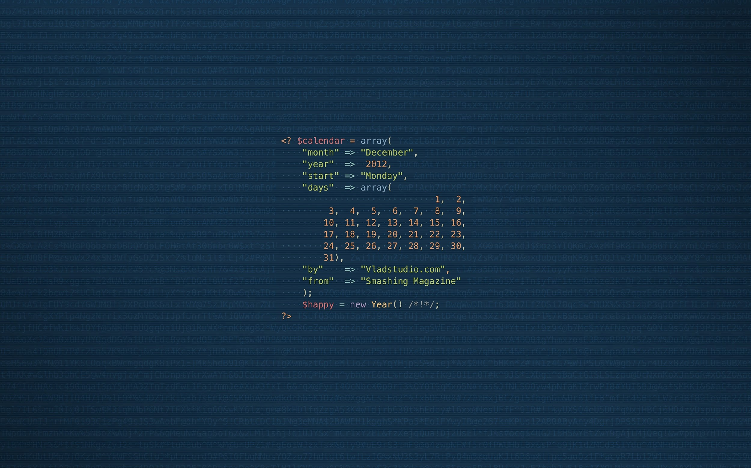
The Technology
Product Features

Slide 6

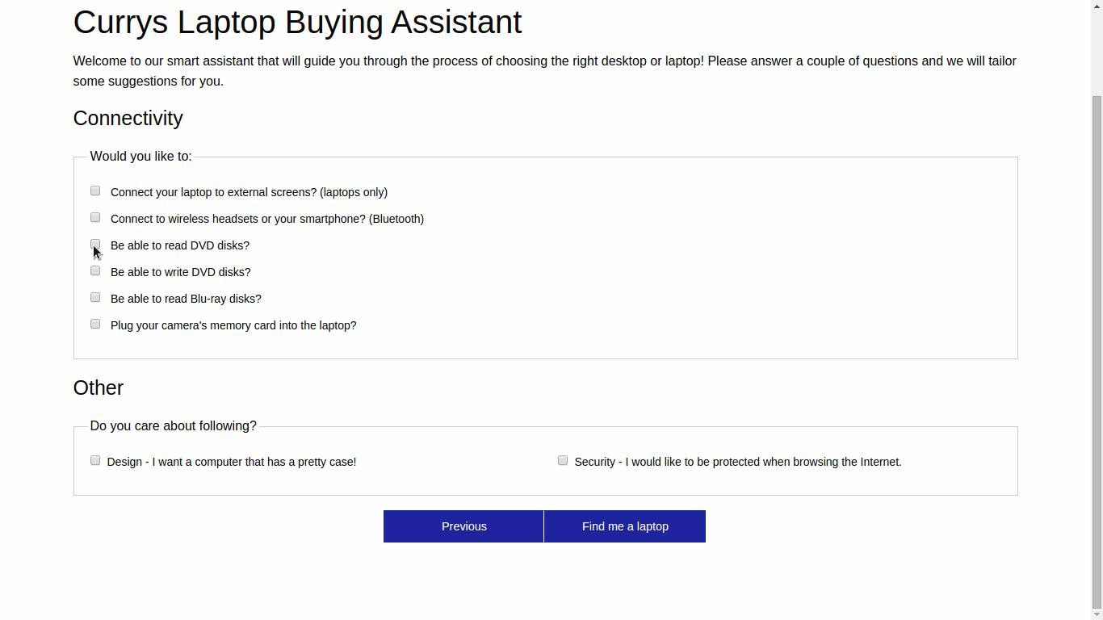
User Experience
The software will make a more informed decision
Comparison between all the computers in their database
“Tailored” laptop or PC
Benefits
Features
Enhancement
Ease of use
Interactive quiz
Curry’s current filter system
Brand loyalty
Matches appropriate product
Notes:
Rather than relying on an employee at Currys
who might not have the knowledge of all the ++200 computers

Slide 7
Business Experience/Potential
Increase demand
Increase profits
Target a bigger audience
Expanding the market
New customers that in the past would not be able to do online purchases

